Slide 1
CSE 881: Data Mining
Lecture 21: Graph-based Clustering

Slide 2
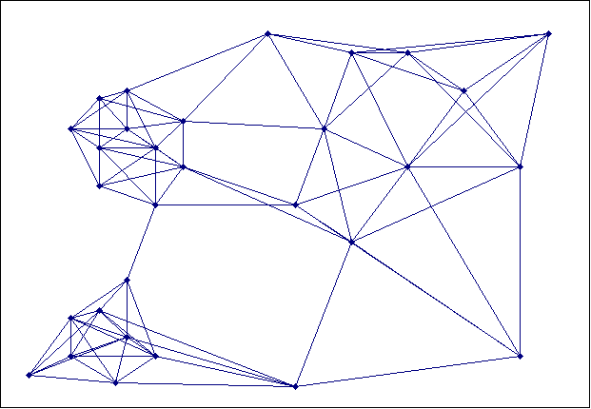
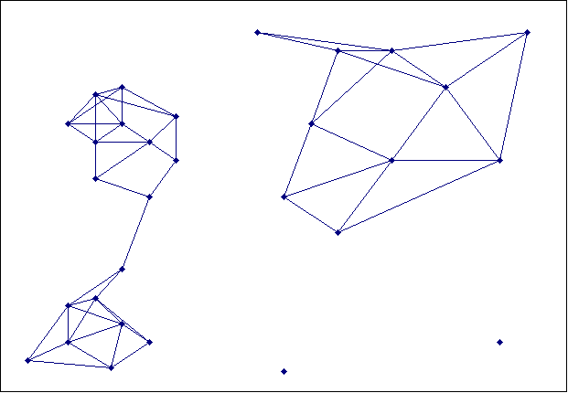
Graph-based Clustering
Let G = (V, E) be a graph
V: set of vertices, E: set of edges
We can transform any data to a graph representation
Vertices are the data points to be clustered
Edges are weighted based on similarity between data points
Clustering can be viewed as graph partitioning problem
Graph partitioning
⇒
Each connected component is a cluster

Slide 3
Clustering as Graph Partitioning
Two things are needed:
An objective function to determine what would be the best way “cut” the edges of the graph
An algorithm to find the optimal partition (optimal according to the objective function)

Slide 4
Objective Function for Partitioning
v₁
v₅
v₁
v₅
1
1
1
1
1
v₃
v₄
v₃
1
v₄
1
1
1
1
v₂
v₆
v₂
v₆
Cut = 1
Cut = 2
Suppose we want to partition the set of vertices V into two sets: V₁ and V₂
One possible objective function is to minimize the cut

Slide 5
Objective Function for Partitioning
v₁
v₅
1
1
v₃
1
Cut = 1
v₄
1
1
v₂
v₆
Limitation of minimizing the cut:
For most graphs, the optimal solution may correspond to partitioning a single node from the rest of the graph (which is not the desired solution)

Slide 6
Objective Function for Partitioning
We should not only minimize the cut; but should also look for more “balanced” clusters

Slide 7
Example
v₁
v₅
v₁
v₅
1
1
1
1
1
v₃
v₄
v₃
1
v₄
1
1
1
1
v₂
v₆
v₂
v₆
Cut = 1
Ratio cut = 1/1 + 1/5 = 1.2
Normalized cut = 1/1 + 1/9 = 1.11
Cut = 1
Ratio cut = 1/3 + 1/3 = 0.67
Normalized cut = 1/5 + 1/5 = 0.2

Slide 8
Algorithm for Graph Partitioning
Next, we need to design an algorithm that minimizes the objective function
We can use a heuristic (e.g., greedy) approach to do this
Example: METIS graph partitioning
There is a more elegant way to optimize the function using ideas from spectral graph theory
This leads to a class of algorithms known as spectral clustering

Slide 9
Spectral Clustering
Next, we’ll do the following
Examine the spectral properties of a graph
i.e., eigenvalues/eigenvectors of the adjacency matrix representation of a graph
Show that graph partitioning (using the balanced cut criterion) is equivalent to examining the spectral properties of the graph

Slide 10
Spectral Properties of a Graph
Start with a similarity/adjacency matrix, W
which captures all the information about the relationships between nodes
Define a diagonal matrix D
If W is a binary 0/1 matrix, then D_{ii} represents the degree of node i

Slide 11
Preliminaries
v₁
v₅
1
1
v₃
v₄
Two block matrices
1
1
v₂
v₆
Two clusters

Slide 12
Graph Laplacian Matrix
v₁
v₅
1
1
v₃
v₄
Two block matrices
1
1
v₂
v₆
Laplacian also has a block structure

Slide 13
Properties of Graph Laplacian Matrix
L = D – W is a symmetric matrix
L is a positive semi-definite matrix
For all real-valued vectors, x: x^{T}Lx ≥ 0
Consequence: all eigenvalues of L are ≥ 0

Slide 14
Properties of Laplacian Matrix

Slide 15
Properties of Laplacian Matrix
Since e ≠ [0..0]^{T}, therefore λ = 0
0 is an eigenvalue of L with the corresponding eigenvector e = [1 1 1 1…1]^{T}
Furthermore, since L is positive semi-definite, 0 is the smallest eigenvalue of L

Slide 16
Properties of Laplacian Matrix
where e is [1 1…1]^{T}
More generally, if
Then
There are k eigenvalues of L which have the value 0
The corresponding eigenvectors are:

Slide 17
Properties of Laplacian Matrix
v₁
v₅
1
1
v₃
v₄
1
1
v₂
v₆
Eigenvalues of L:
Eigenvectors of L:

Slide 18
Properties of Laplacian Matrix
v₁
v₅
1
1
v₃
v₄
If we cluster the data using only the first 2 eigenvectors, we get the two desired clusters
1
1
v₂
v₆
Eigenvalues of L:
Eigenvectors of L:

Slide 19
Properties of Laplacian Matrix
v₁
v₅
1
1
v₃
1
v₄
1
1
v₂
v₆
Clusters are no longer well separated

Slide 20
Properties of Laplacian Matrix
v₁
v₅
1
1
v₃
1
v₄
1
1
v₂
v₆
Eigenvalues of L:
Eigenvectors of L:

Slide 21
Properties of Laplacian Matrix
Eigenvalues of the graph Laplacian: 0, 0.5505, 0.5505, 3, 3, 3, 3, 5.4495, 5.4495
Eigenvectors of Laplacian:
Can be used to obtain 3 clusters

Slide 22
Summary
Spectral properties of a graph (i.e., eigenvalues and eigenvectors) contain information about clustering structure
To find k clusters, examine the first k eigenvectors of the graph Laplacian matrix
Spectral clustering is an algorithm that does this

Slide 23
Spectral Clustering vs Graph Partitioning
So far, we have shown that clusters can be found by examining the spectral properties of the graph
How does this relate to the objective function of minimizing graph cut?

Slide 24
Graph Partitioning
Recall the following objective of graph partitioning

Slide 25
Ratio Cut
Let x_{i} indicates the membership of a node in a cluster:
We can show that:
Which means that finding V₁ and V₂ that minimizes RatioCut is equivalent to finding x that minimizes x^{T}L x where L is the graph Laplacian matrix

Slide 26
Ratio Cut
So minimizing ratio cut is equivalent to finding:
subject to the following constraints:
Good! We have related ratio cut to Laplacian matrix L
But what does this have to do with finding eigenvalues and eigenvectors of L?

Slide 27
Ratio Cut
subject to:
This is a constrained optimization problem where
Instead, we solve a relaxation of the problem:

Slide 28
Spectral Clustering with Ratio Cut
But λ_{min}=0 with eigenvector 1 = (1 1 1…1)^{T}
Since we want a solution where x^{T}1 = 0, so x ≠ 1
Instead of the smallest eigenvalue, we look for the eigenvector corresponding to the next smallest eigenvalue
In summary, finding the eigenvector that corresponds to the second smallest eigenvalue is a relaxation of the normalized mincut graph partitioning problem (for k=2)

Slide 29
Spectral Clustering
Consider a data set with N data points
Construct an N × N similarity matrix, W
Compute the N × N Laplacian matrix, L = D – W
Compute the k eigenvectors of L
Each eigenvector v_{i} is an N × 1 column vector
Create a matrix V containing eigenvectors v₁, v₂, .., v_{k} as columns (you may exclude the first eigenvector)
Cluster the rows in V using k-means or any clustering algorithm

Slide 30
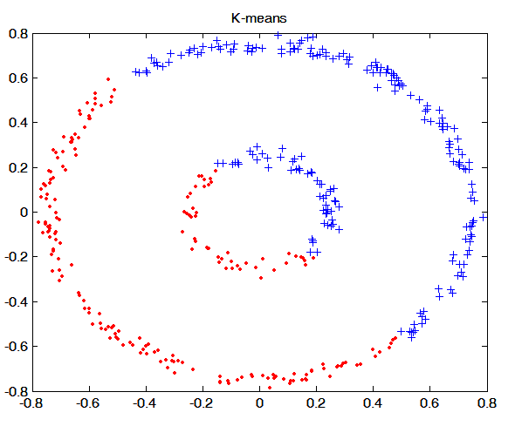
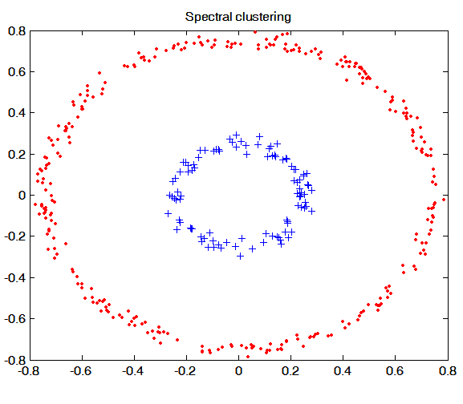
Example

